Slide 1
Spreadsheet Project: IT Ticket Analysis

Slide 2
Agenda
Problem Statement
Data Description
Charts for Visualization
Dashboard
Insights
Conclusion

Slide 3
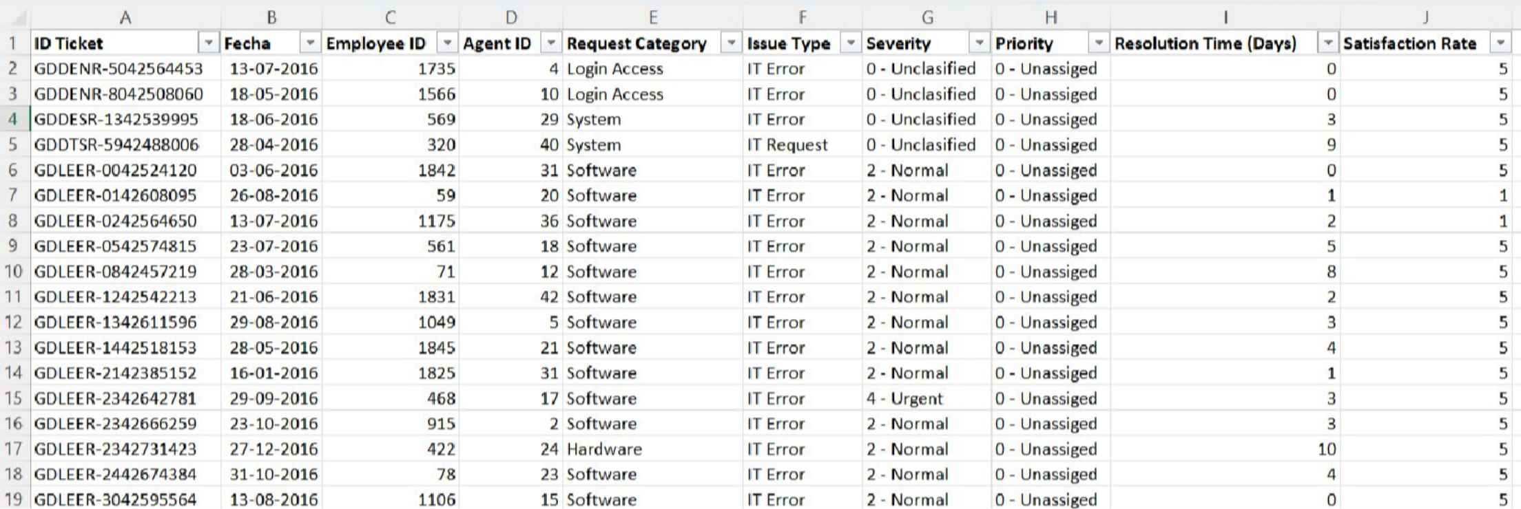
Problem Statement
Call centers handle thousands of customer support tickets across different categories, priorities, and severity levels. Without effective data analysis, it becomes difficult to monitor operational performance, identify service bottlenecks, and make informed investment decisions.
This project aims to analyze IT ticket data from 2016–2020 to evaluate key performance metrics such as ticket volume, resolution time, customer satisfaction, agent performance, and request distribution. The goal is to develop an interactive dashboard that provides actionable insights and supports data-driven decisions to improve operational efficiency and customer service.
.

Slide 4
The image above displays details about IT Ticket Information, including:
Tickets Sheet: Contains information about IT support tickets.
ID: Unique identifier for the ticket.
Ticket Fecha: Date of the ticket.
Employee ID: ID of the employee who raised the ticket.
Agent ID: ID of the agent assigned to the ticket.
Request Category: Category of the request (e.g., Login Access, System, Software).
Issue Type: Type of issue (e.g., IT Error, IT Request). Severity: Severity of the issue.
Priority: Priority level of the issue.
Resolution Time (Days): Time taken to resolve the ticket. Satisfaction Rate: Satisfaction rate provided by the employee (1-5 scale).
IT Agents: Contains information about IT agents.
Agent ID: Unique identifier for the agent.
Full Name: Full name of the agent. Email: Email address of the agent. Year of Birth: Year the agent was born.
Month of Birth: Month the agent was born.
Day of Birth: Day the agent was born.

Slide 5
Slide 3 :Data Cleaning
Objective: Ensure the dataset is accurate, consistent, and ready for analysis
Data Cleaning Steps Performed
Removed duplicate records (if any).
Checked for and handled missing or blank values.
Verified that Resolution Time (Days) and Satisfaction Rate were stored as numeric values.
Reviewed categorical fields (Priority, Severity, Request Category, Issue Type, Agent Name) for consistency and corrected formatting where needed.
Validated Ticket IDs to ensure each record was uniquely identifiable
Outcome
Clean and consistent dataset.
Reliable KPIs and charts.
Improved accuracy of performance analysis and investment recommendations.
IDs to ensure each record was uniquely identifiable

Slide 6
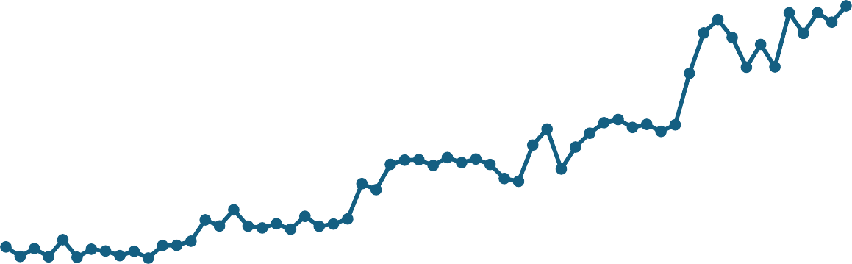
Slide 4 : Ticket Volume Trend
Monthly Ticket Trend
This chart shows how ticket volume changed between 2016 and 2020. We can observe fluctuations in the number of support requests, with some periods experiencing higher demand than others. These trends help management anticipate peak workloads, optimize staffing levels, and plan resources more effectively to maintain service quality
3000
2500
2000
1500
1000
500
0
Jan
Mar May Jul Sep Nov Jan Mar May Jul Sep Nov Jan Mar May Jul Sep Nov Jan Mar May Jul Sep Nov Jan Mar May Jul Sep Nov

Slide 7
Slide 5: Tickets By Priority
Tickets By Priority
40000
This chart shows the distribution of tickets
based on priority. High-priority tickets form a significant part of the workload and require
35000
30000
immediate attention to impact. By monitoring
minimize
priority
business trends,
25000
management can allocate resources more effectively, improve response times, and ensure that critical issues are resolved quickly.
20000
15000
10000
5000
0
0 - Unassigned
1 - Low
2 - Mid
3 - High

Slide 8
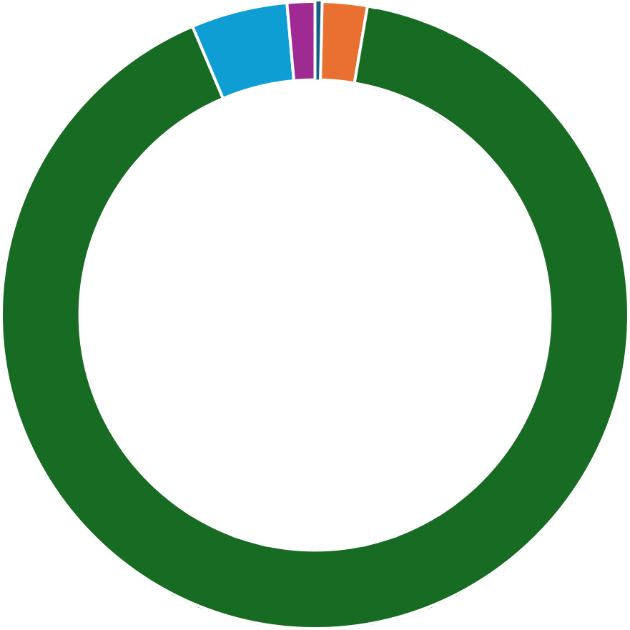
Slide 6: Tickets By Severity
This chart illustrates the distribution of tickets by severity. Most tickets are classified as Normal, indicating that routine support requests make up the majority of the workload. Although Urgent and Major tickets are fewer in number,
Tickets By Severity
they have a greater impact on operations and therefore require
business immediate
attention. Monitoring ticket severity helps the organization prioritize resources and improve overall service quality
- Unclassified
- Minor
- Normal
- Major
- Urgent

Slide 9
Slide 7:Request Category Distribution
Tickets By Request Category
This chart shows the distribution of tickets across different request categories. System-related requests generated the highest number of tickets, followed by Login Access and Software issues. Since these categories account for a large portion of the workload, implementing automation and self-service solutions can reduce repetitive requests, improve operational efficiency, and allow IT agents to focus on more complex issues
System
Software
Login Access
Hardware
0
5000 10000 15000 20000 25000 30000 35000 40000 45000

Slide 10
Slide 8:Resolution Time Trend
This chart shows the average resolution time over five years. The trend remains relatively stable, with only minor fluctuations between 2016 and 2020. Although resolution time increased slightly in 2020, overall performance has been consistent.
Average Resolution Time Vs Years
4.6
4.58
4.56
4.54
4.52
4.5
4.48
2016
2017
2018
2019
2020

Slide 11
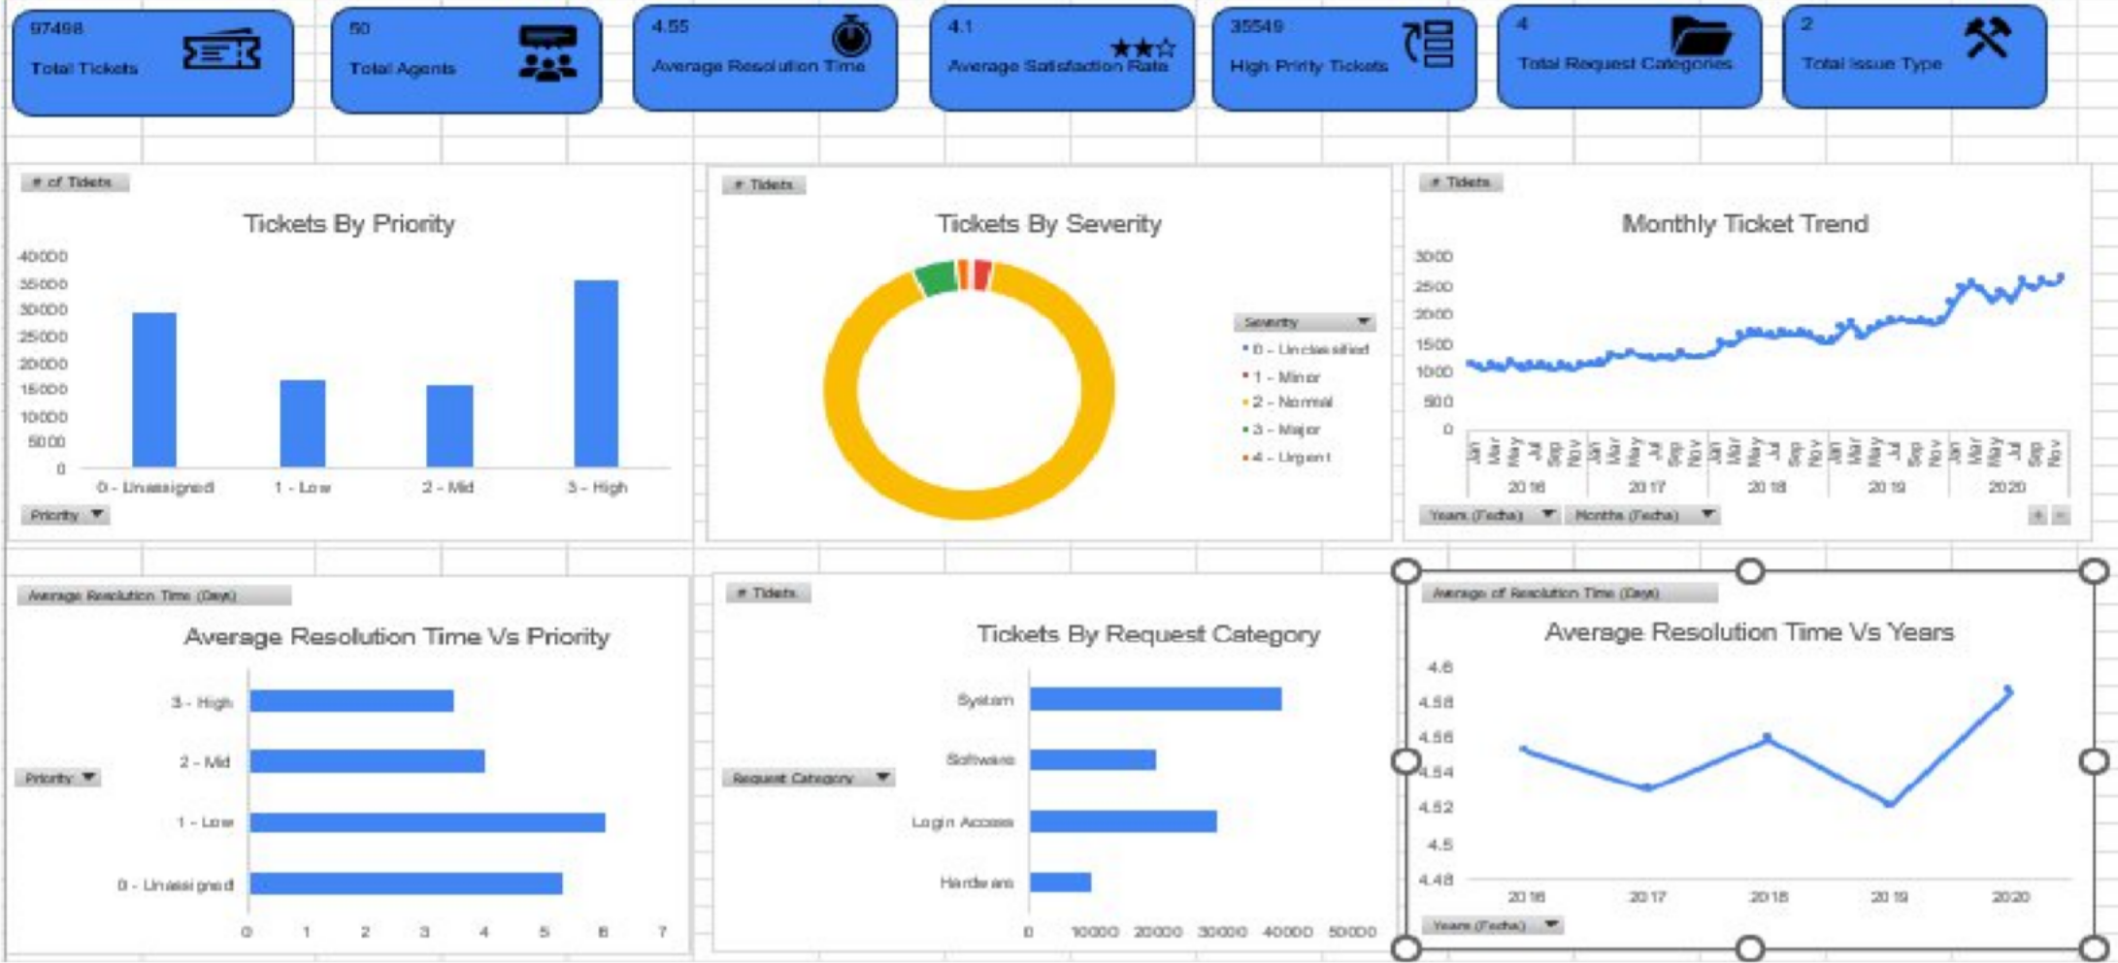
Slide 9 :Screen Shot Of Dashboard

Slide 12
Slide 10: Recommendation
Based on the analysis, the organization should focus on automating high-volume request categories, improving resolution times through training and process optimization, allocating resources more effectively during peak periods, and strengthening ticket prioritization. Continuous monitoring through the dashboard will help management make informed decisions and improve overall call center performance

Slide 13
Slide 11: Conclusion
The analysis of 97,498 IT support tickets (2016–2020) provided valuable insights into call center performance and operational efficiency.
The interactive dashboard successfully monitored key metrics such as ticket volume, priority, severity, resolution time, customer satisfaction..
The findings highlighted opportunities to improve service quality through faster resolution
times, better ticket prioritization, balanced workload distribution, and automation of high- volume request categories.
The dashboard serves as an effective decision-support tool, enabling management to
make data-driven investment decisions that enhance customer satisfaction and optimize call center operations.
•
Final Statement
By transforming raw ticket data into actionable insights, the dashboard empowers
management to improve operational efficiency, optimize resource allocation, and deliver a better customer support experience.

